Slide 1
Agenda
Business Requirements
Executive Summary
Data Analysis
Insights and Recommendations
Roadmap

Slide 2
Business Requirements
We are interested in analyzing Kmart results, so the business can
Understand Overall Results and Patterns, in terms of Margin, Revenue, # Orders, # Customers, over time or across different products/regions
Discuss business strategies and recommendations, based on previous agreed questions around product, pricing and customer behaviour

Slide 3
Executive Summary
In 2019
Product Margin of 58% (20M),
140k customers, 178k orders, 208k products sold
90% of time, a customer brings a margin up to 400
Result is driven by products (laptop and mobile) that are not bought recurrently
13% of customer base buys orders with more than 1 product, that typically include product lines from mobile, cable/access and audio (detailed information in upcoming slides)
22% of customer base buys again. A recurrent customer is typically buying across Audio and Cable/Access (detailed information in upcoming slides)
There are multiple business opportunities around pricing (based on demand) and product (up-sell, cross-sell) and 1 risk around product portfolio dependency

Slide 4

Dataset
It shows 2019 sales results (185k rows)
The data is broke down by
product name, product line
order date
order id
product quantity
unitary product price/cost
revenue/cost/margin
customer address

Slide 5



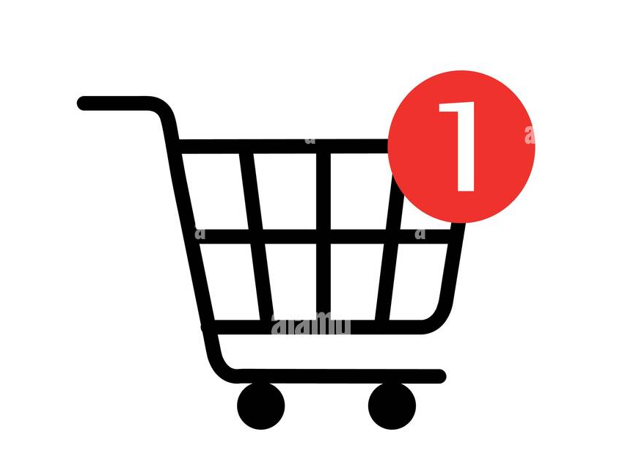



Overall Results (1/3)
In 2019
140.7k customers
178.4k orders
208.7k
products sold
86% of orders have 1 product
34.3M Revenue
14.3M
Cost
20.0M (58%)
Margin

Slide 6

Overall Results (2/3)
In 2019
Top 3 Qty ordered (85%)
Cables and Acces. 50% (105k)
Audio 24% (49k)
PC/Video Games 12% (24k)
Top 3 Margin (78%)
Computer/Laptop 41% (8.3M)
Mobile 20% (4.1M)
PC/Video Game 17% (3.4M)
Top 3 Qty ordered (39%)
AAA Batteries 15% (31k)
AA Batteries 13% (27k)
USB-C Cable 11% (24k)
Top 3 Margin (54%)
Macbook 28% (5.6M)
iPhone 13% (2.7M)
ThinkPad 13% (2.6M)
7 Product Lines
19
Products
There is not product or product line with margin loss
For product line and product, quantity of orders and margin are not correlated

Slide 7
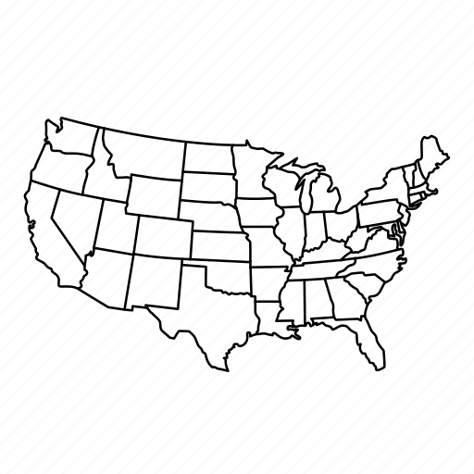

Overall Results (3/3)
In 2019
CA (Los Angeles and San Francisco) and TX (Austin and Dallas) have customer from 2 cities. Remaining states from 1 city.
State
Top 3 # Orders (66%)
CA 40% (71.3k)
NY 13% (23.8k)
TX 13% (23.7k)
Top 3 Margin (66.5%)
CA 40% (7.9M)
NY 13.5% (2.7M)
TX 13% (2.6M)
City
Top 3 # Orders (53%)
CA, San Francisco 24% (42k)
CA, Los Angeles 16% (28k)
NY, New York 13% (23k)
Top 3 Margin (53%)
CA, San Francisco 24% (4.8M)
CA, Los Angeles 15% (3.1M)
NY, New York 13% (2.7M)
8 States
10 Cities
There is not state or city with margin loss
For state and city, quantity of orders and margin are correlated

Slide 8
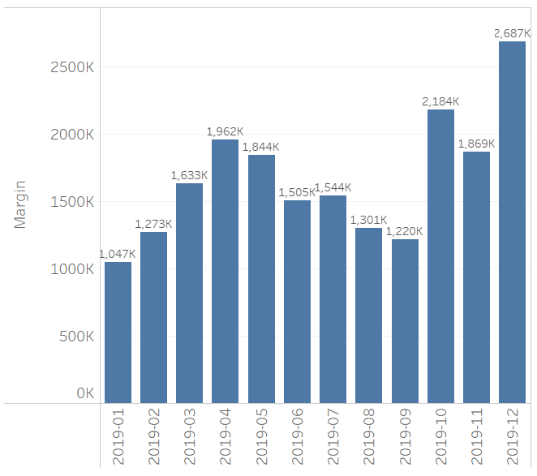
Overall Patterns: Metrics over time
Bar plot shows Margin Levels across months
The pattern repeats for other levels (Revenue, Costs, # Order, # Product, # Customer).
Levels are higher in Q4 and Q2: Dec, Oct, April
Mainly due to Macbook, iPhone and Thinkpad
Why? Likely hypothesis is due to date seasonality (see support slides for details)
Changing X axis
Levels are similar around days of the month and weekdays.
Levels are higher from 11h to 13h and from 19h to 21h: promote specific ads on these time frames (online or in-store)

Slide 9
Product/Region Performance tracker over time
Interested in identifying “tiered” behaviour (Highest, High, Medium, Low), based on Margin and Quantity across months, slicing by Product and Region. See supporting slides for detailed analysis
Region
It repeats the pattern at Overall Results:
San Francisco, Los Angeles, and New York are Highest group.
Portland, ME has far low performance and seasonality compared to others. Why?
Product
Margin:
Highest: Macbook
Low: Vareebadd phone, 20in Monitor, Lightning Cable, USB-C Cable, LG Washing Machine, Wired Headphones, LG Dryer, AA Batteries, AAA Batteries
Quantity:
Highest: AAA Batteries, AA Batteries, USB-C cable, Lightning Cable, Wired Headphones
Low: Vareebadd phone, LG dryer, LG washing
Household product line captures attention, since it has low for margin and quantity

Slide 10
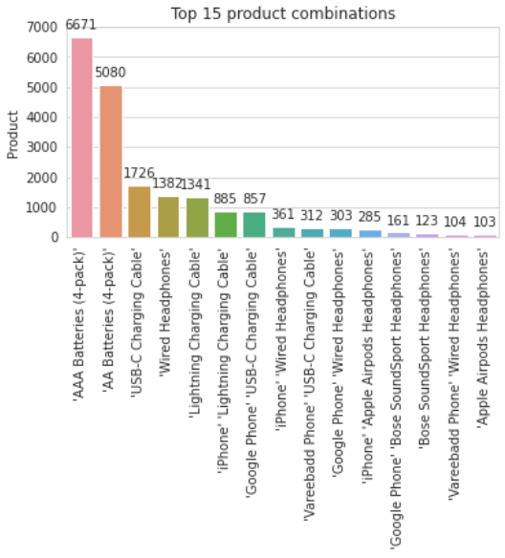
Product Basket Analysis
23.3k orders (13.1% of 178.4k) with more than 1 product
Typically these orders have 2 products
2.0M of margin, or 10.4% of all margin result
362 combinations of orders with multiple products
Multiple units from same product
The first 2 combinations happened +5k times, the next 5 between 800 and 1.7k, and the remaining less than 370
Products lines from Mobile, Cable/Access., Audio. Given order would have:
Multiple Batteries packs
Multiple Charging Cables
Multiple wired headphones
Mobile + Charging cable
Mobile + Headphone
Products with good
percentual margin: batteries, lightning cable, usb-c cable, headphone (wired, bose, apple)
absolute margin: iPhone, apple headphone

Slide 11
Customer Behaviour
30.7k customers (21.9% of 140.7k) are recurrent
Top 3 Recurrency times
78.1% buy once
17.8% re-buy twice
3.4% re-buy 3 times
Product Recurrency
A recurrent customer is typically purchasing around Audio and Cable/Access
Batteries + Charging Cable
Charging Cable
Wired/Apple Headphones + Charging Cable
Batteries
Apple/Bose/wired Headphones + Batteries
Wired Headphones
Products with good
percentual margin: batteries, charging cable, cable, headphone (wired, bosed, apple)
absolute margin: apple headphone
Customers from San Francisco, Los Angeles, New York and Boston tend to be more recurrent and to have better margin
90% of customers bring an individual annual margin up to 400

Slide 12
Insights and Recommendations
Area | Discussions / Concerns | Area | Discussions / Concerns
Pricing | Under which circumstances could we adjust (increase/decrease) the price? Are the prices in-line with the market reality? | Customer Behaviour | What is the product recurrency profile? How do I find more people that buy recurrently? Where do I find more customers that have higher margin (regardless if it is recurrent)?
Product | Can we do: up-selling, cross-selling? Which products captured our attention and why? What are the product portfolio risks?

Slide 13
Insights and Recommendations
Pricing
Increase price when demand is higher: Apr, Oct and Dec
Additional investigation to be done with marketing to understand effects on customer willingness vs price increase.
Macbook: from 1700 to, 1800 (5% increase) (additional revenue 162k*)
Apple headphone: from 150 to 170 (13% increase) (additional revenue 105k*)
Bose headphone from 100 to 120 (20% increase) (additional revenue 91k*)
* check support slides. Assume volume in Apr, Oct, Dec doesn't change for respective products
Decrease price when demand is lower: Aug and Jan, for products with high percentage margin (around 60%)
Additional investigation to be done with marketing to understand demand increase vs price decrease
Macbook - from 1700 to 1500 (12% discount, cost is 500)
Apple Headphone- from 150 to 130 (13% discount, cost is 45)
Are the prices in-line with the market reality?
If there is no existing internal competitor pricing comparison, or easy-access external report, develop a quick price ecommerce web scraper, to compare if our prices are in line with the market reality.

Slide 14
Insights and Recommendations
Product
Up-selling: Engage with customer for a product update
Product (with good margin and value-added product)
From Thinkpad (1000) to Macbook (1700)
Google (600) to iPhone (700)
20in monitor (110) to 27in FHD (150)
Bose headphones (100) to Apple Airpods (150)
Channel Mechanism
Online (passive): customer adds item to basket, and is about to close the deal. An upsell offer appears.
In-store (active): sales consultant will place the order, but before closing the deal, engages to convince customer to up-sell. Sales consultant will get a % commission of difference between the expensive and cheaper.

Slide 15
Insights and Recommendations
Product
Cross-selling (based on product basket analysis and product recurrency, and products with percentual margin to squeeze)
iPhone (700) + Apple Airpod Headphone (150), where headphone is 33% off (from 150 to 100).
Mobile + Headphone is a common product set.
Revenue 800 (700 + 100), cost 345 (45+300), margin 455 (56% margin)
Batteries + Batteries
Buy 3 packs (of the same product) and get 1 free
AA Batteries: revenue 11.52 (3 x 3.84), cost 4.8 (4 x 1.2), margin 6.72 (58% margin)
AAA Batteries: revenue 9 (3 x 3), cost 4.4 (4 x 1.1), margin 4.6 (51% margin)
USB-C Charging Cable + Batteries
Buy 1 USB-C Cable and 2 packs of battery, get a 1 pack of battery free
USB-C + AA: revenue 19.63 (11.95+ 2x3.84), cost 7.4 (3.8 + 3x1.2), margin 12.23 (62% margin)
USB-C + AAA: revenue 17.93 (11.95+ 2x2.99), cost 7.1 (3.8 + 3x1.1), margin 10.83 (60% margin)

Slide 16
Insights and Recommendations
Product
Products that captured attention
Washing Machine and Dryer Machine
Reflect on how are they adding value to the customers
They have lower volume, lower margin and lower percentage margin. But still, leave a positive margin.
Reflect on what is the effort/cost to maintain the supply chain, marketing and sales activities for these products
AA/AAA Batteries
Together they have 131k margin (0.6%) , 59k volume (28%), 40k customers, 161 packs sold daily
Batteries are bought recurrently
Why are people buying so much with us?
Due to price? Due to demand?
People are using batteries with products that we don’t sell
Is battery a bait that bring people to us?
How is our pricing compared to the competition?

Slide 17
Insights and Recommendations
Product
Product Portfolio Risk
Supplier/Brand diversification
50% of margin (10M) comes from Apple (Macbook, iPhone and Airpod headphones).
It is important to identify an take care of “super products”.
At the same time, it is a wise and healthy strategy to not depend a lot exclusively on 1 product/brand/product line.
Reflect: what are the similar or complementary products from other premium brands, that make sense to our customer base?

Slide 18
Insights and Recommendations
Customer Behaviour
What is the product recurrency profile?
A recurrent customer is typically purchasing around Audio and Cable/Access:
Batteries + Charging Cable; Charging Cable; Wired/Apple Headphones + Charging Cable; Batteries; Apple/Bose/wired Headphones + Batteries; Wired Headphones
How do I find more people that buy recurrently?
Cities like San Francisco, Los Angeles, New York, and Boston have more customers that buy more recurrently.
Limitation: Additional information on customer profile (demographics and behavioural data) would help to provide deeper insights.
Where do I find more customers that have higher margin (regardless if it is recurrent)?
Same as above

Slide 19
Roadmap (1/2)
Develop a Monitoring Panel Report at Tableau
Upper section: a date range slider - comparing actual data to target data for yearly target for Sales, Margin, Cost
Lower section: Map (show states and cities colored to give notion of coverage), click in given state to show total sales, total order, total shipping, total costs, total margin, total customers, for a given date range
Develop an internal application to simulate/predict customer willingness/demand based on price adjust (increase/decrease)
ML use cases
Customer segmentation analysis
Predict product demand, using regression and/or time series forecast
Use a association rules, to get detailed understanding on common groups of products sold together (as “iPhone + Headphone” is handled different than “Headphone + iPhone” as it is now)
Do more analysis in terms of
promotion (how are our initiatives in terms of ads, either online or in-store? Which products could we advertise?)
place (what is our territory and coverage performance? Should we invest in new places or improve existing?)
Understand why price was fixed over the year (this is a toy dataset, but this question would make sense in a real business context)

Slide 20
Roadmap (2/2)
Get customer base profile data to understand customer behaviour, to improve process around: customer acquisition (awareness, consideration, signup), retention and advocacy
Understand why are we not selling more products? It is a theoretical question for this assessment, but useful in a real project
Get more data from other channels and platforms
Collect data for more years: 2016, 2017, 2018, 2020, 2021
Break down between online and in-store purchase (we know sales out of working hours are online, but in working hours we don't know the mix)
Feature engineering: combine other datasets
Suppply Chain data: delivery time such products, stock levels, freight
Taxes, Profit, Cashflow
Customer Survey - for given purchase and for how customer perceives Kmart
Holidays: flag data that is a week before holiday, since it’s typically when people tend to buy products for that holiday

Slide 21
Support Slides

Slide 22
Overall Patterns: Metrics over time (Support Slides)
Analysis when levels are higher (Apr, Oct, Dec)
It’s equivalent to the Overall Results (for Margin and # Customer/Order)
For Product Line
Top 3 #: Cable and Access, Audio, PC/Video Game
Top 3 Margin: Computer, Mobile and PC/Video game
For Product
Top 3 #: Charge cable, Batteries
Top 3 Margin: Macbook, iPhone, Thinkpad
State, City
Top 3 Margin and #: SF, LA, NY
Hypothesis: it looks to be more related to date seasonality
Apr (Good Friday, Easter),
Oct (Columbus Day, Halloween)
Dec (Year end, Christmas)
Weirdly enough, Thanksgiving and BlackFriday did not have peaks

Slide 23
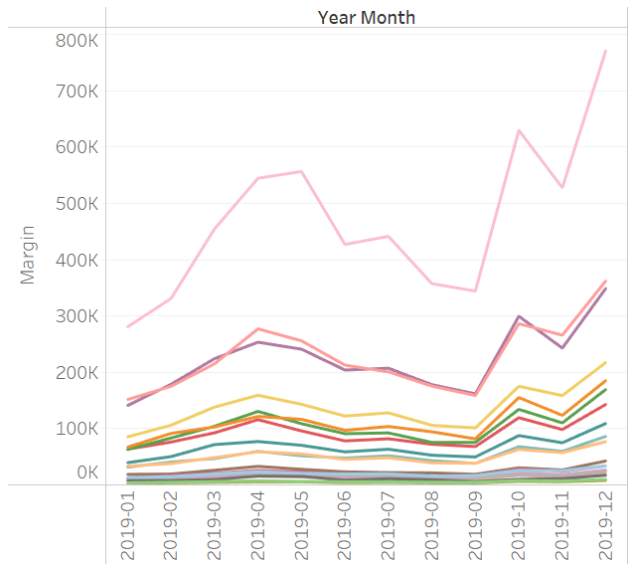
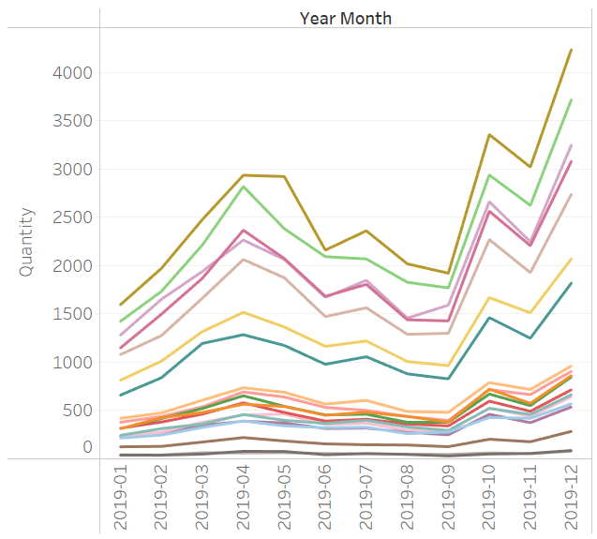
Product/State/City Performance tracker over time (Support slide)
Product Tier based on Margin and Quantity
Highest: Macbook,
High: iPhone, Thinkpad
Medium: Apple Airpods, Gaming monitor, Ultrawide monitor, Google phone, Bose headphones, Flat Screen TV, FHD monitor
Low: Vareebadd phone, 20in Monitor, Lightning Cable, USB-C Cable, LG Washing Machine, Wired Headphones, LG Dryer, AA Batteries, AAA Batteries
Highest: AAA Batteries, AA Batteries, USB-C cable, Lightning Cable, Wired Headphones
High: Apple airpods, Bose headphone
Medium: FHD monitor, iPhone, Gaming Monitor, Ultrawide Monitor, Google phone, TV, Macbook, 20in Monitor, Thinkpad
Low: Vareebadd phone, LG dryer, LG washing

Slide 24
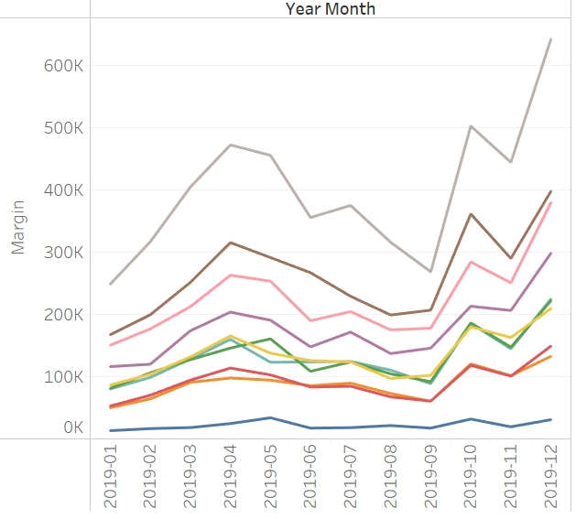
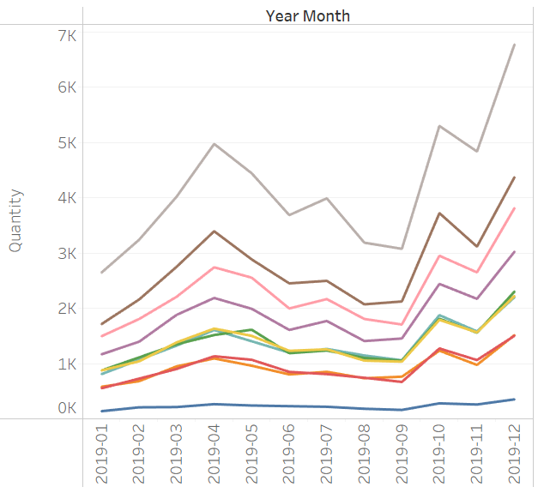
Product/State/City Performance tracker over time (Support slide)
City Tier based on Margin and Quantity
Highest: San Francisco, Los Angeles, New York
Medium: Boston, Seattle, Dallas, Atlanta, Portland (OR), Austin
Low: Portland (ME)
Highest: San Francisco, Los Angeles, New York
Medium: Boston, Seattle, Dallas, Atlanta, Portland (OR), Austin
Low: Portland (ME)

